Slide 1

NYC TAXI DATA analysis

Slide 2
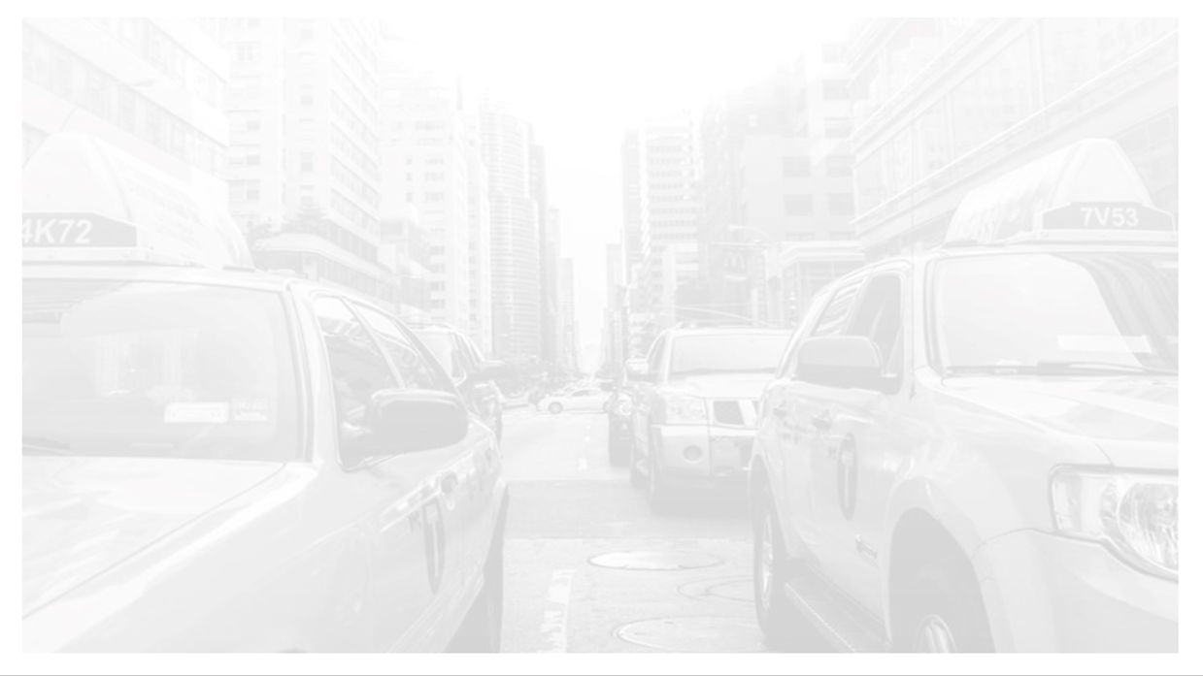
Data set summary
Trip data & Fare data for the month of April 2013 available as two csv files
1000000 data points considered for analysis
Two unique vendors for taxis : VTS & CMT
13105 unique taxis
29800 unique drivers

Slide 3
Data cleaning
Removing erroneous trips from the data:
Removed trips with zero trip time
Removed trips with zero passengers
Removed trips with trip distance as zero
Removing anomalous latitude & longitude values in pickup & dropoff coordinates
Removing trips where taxi speed is greater than 250 mph

Slide 4
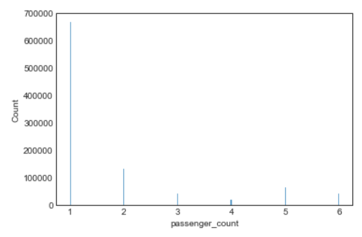
Exploratory data analysis
Passenger count
Nearly 6,60,000 trips with solo riders that constitutes about 68% of the rides
Least number of trips are with 4 passengers
The distribution is right-skewed (or Positive skewed) with skewness of ~1.84. (Since this is ordinal data, calculating skewness do make sense)

Slide 5
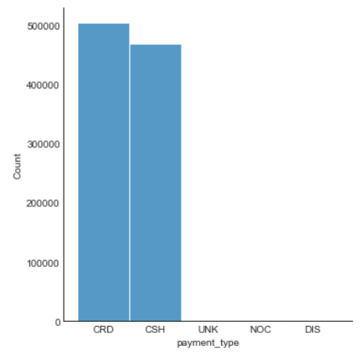
Exploratory data analysis
Payment mode
5 unique payment modes : CRD, CSH, UNK, NOC & DIS
Credit(CRD) & Cash(CSH) are the most popular payment modes (99% of total payments)
~52% of payments are through Credit
~47% of payments are through Cash

Slide 6
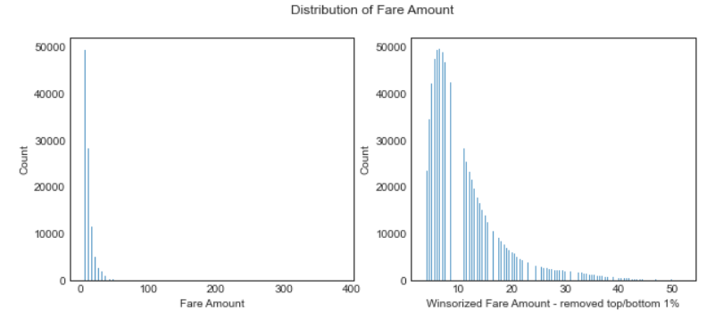
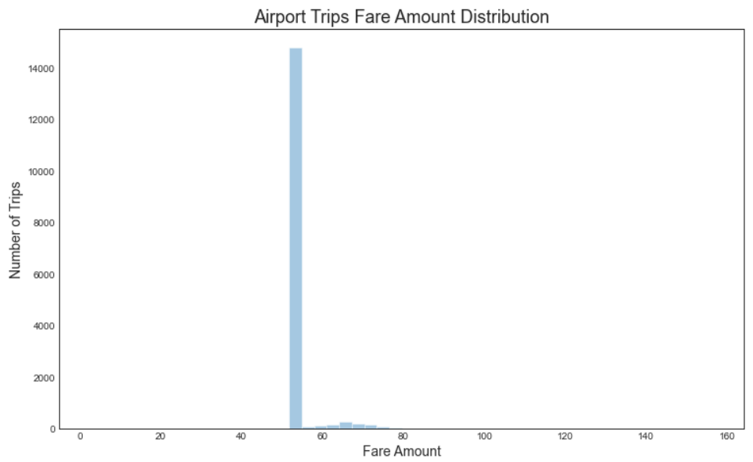
Exploratory data analysis
Fare amount
Lowest fare is $2.50
Distribution is heavily positively skewed
Most expensive trip is $385, but most trips are under $50
Median trip fare is $9.5 & standard deviation is $9 after winsorizing
Airport rides have a median of $52

Slide 7
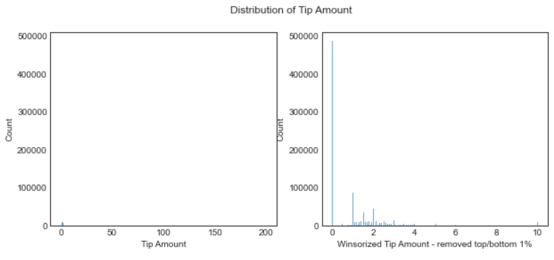
Exploratory data analysis
TIP amount
Most passengers do not tip well
49.86% of trips are having zero tips
This could also indicate that tips are not properly reported by the drivers or errors in data collection

Slide 8
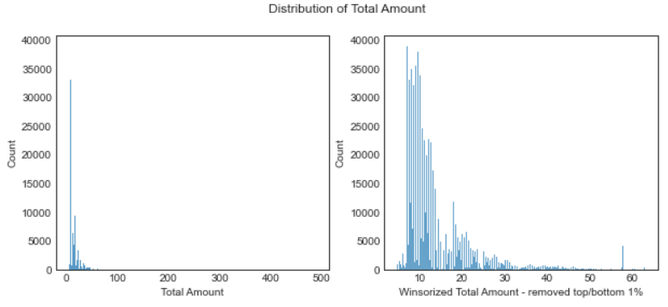
Exploratory data analysis
Total amount
Since tips are very low, total amount follows similar distributions as fare amount
The distribution is heavily positively skewed
Winsorized total fare has a median value of $11

Slide 9
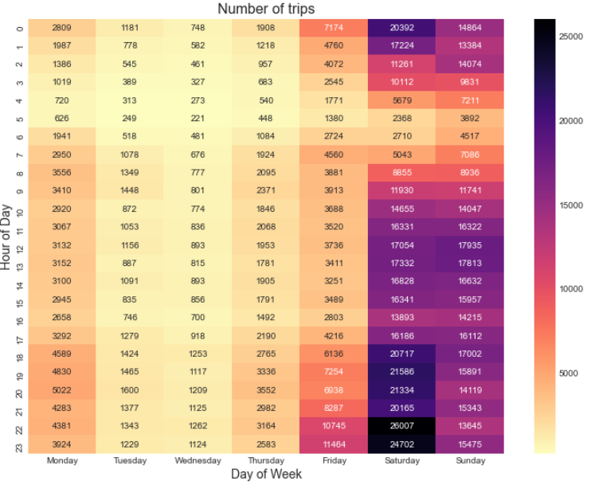
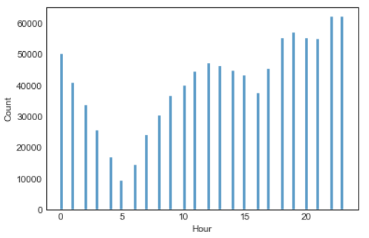
Exploratory data analysis
Top 5 busiest hours of the day
Weekend evenings are the busiest
Top 5 busiest hours are 10pm, 11pm, 7pm, 6pm & 8pm

Slide 10
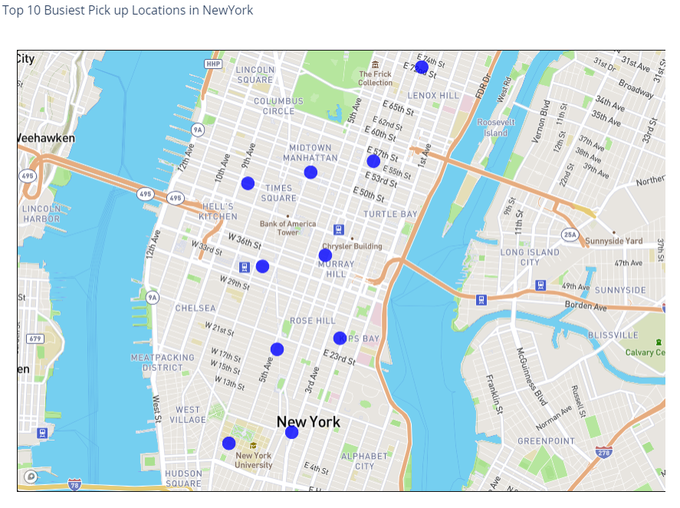
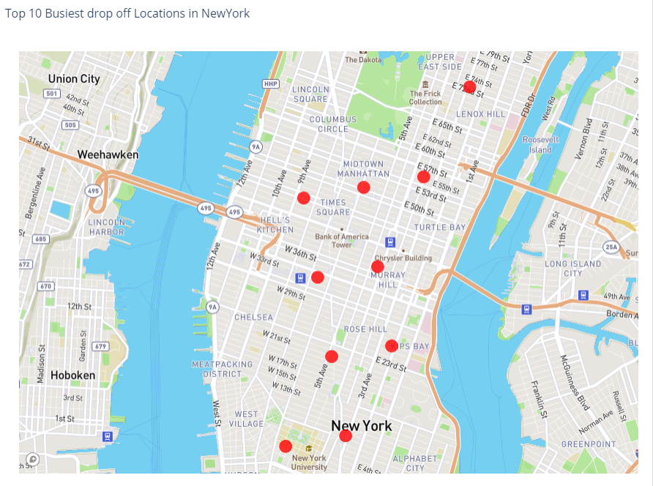
Exploratory data analysis
Top 10 busiest locations of the city
The top 10 busiest locations are all in Manhattan

Slide 11
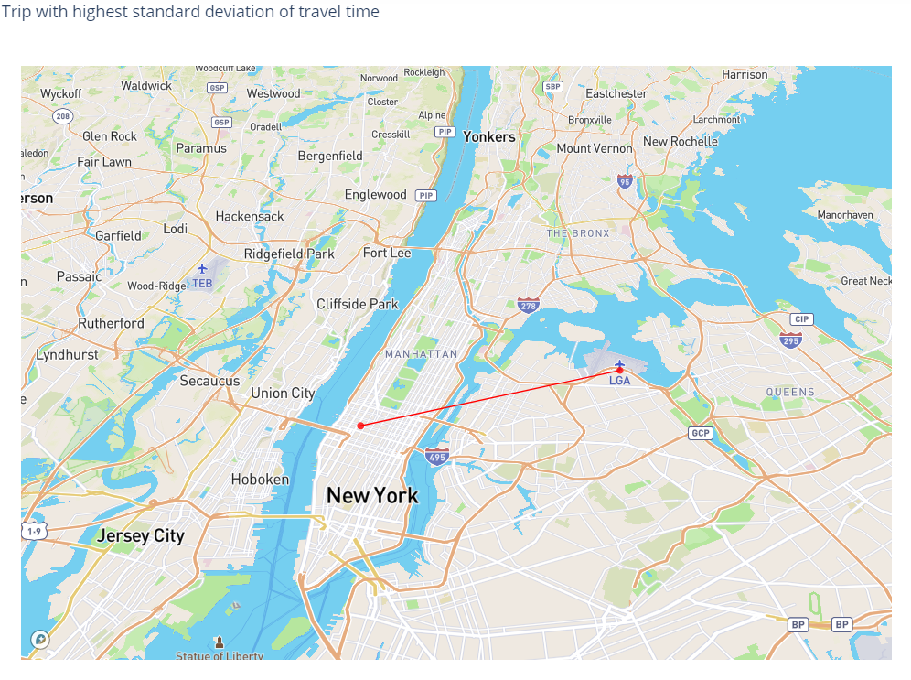
Exploratory data analysis
Trip with highest standard deviation of travel time
Airport trips have the highest standard deviation of travel time
Trip with highest standard deviation of travel time is between the Laguardia airport & Times Square, Manhattan with a standard deviation of ~630 seconds

Slide 12
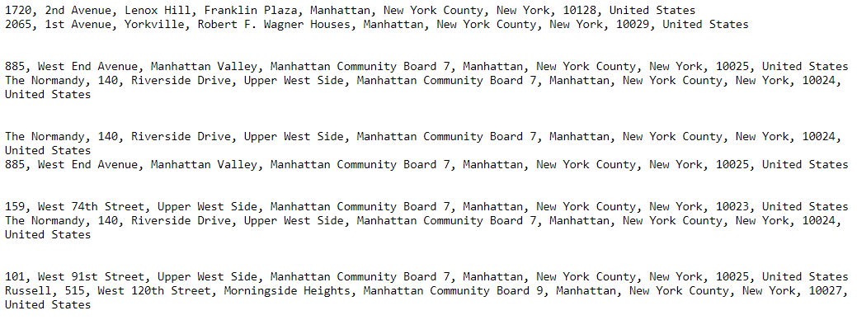
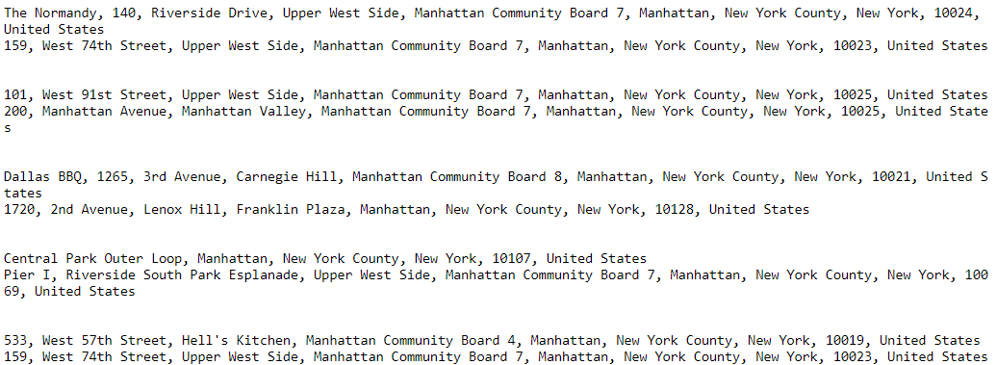
Exploratory data analysis
Trip with most consistent fares
Most consistent fares are those trips with the least standard deviation of fare amounts
These are mostly short trips within Manhattan

Slide 13
Open questions
Trips which can use means as measure of central tendency
Margin of Error = 5%
Confidence Interval = 95% -> Z-Score = 1.96
Standard Deviation = 50%
Sample Size = (1.96*0.5/0.05)^2 = 385 trips
Trips with at least 385 sample points can be used for estimating population parameters
Most of the trips which originate and end in Manhattan, including trips to La Guardia or JFK airports are such

Slide 14
Open questions
Model to predict fare & tip amount
Features used:
Pickup & drop off coordinates
Pickup and drop off hour
Day of the week
Day of the month
Haversine distance between the pickup & drop off locations
Distance to the three airports JFK,EWR & LGA to pickup or drop off whichever is nearest
The

Slide 15
Open questions
Model to predict fare & tip amount
Model development
Baseline model : Linear Regression
Training: rmse = 3.73
Test : rmse = 3.7
Random Forest Model
Training: rmse = 2.02
Test : rmse = 3.04
XGBoost model
Train : rmse = 2.35558
Test : rmse = 2.92634
Linear regression & Random forests are vanilla models without any hyperparameter optimization
Grid search CV used for hyperparameter optimization with XGBoost
A separate test & validation set is not used now, which could be used for improving model generalization power
More data can be used for improving model performance
Similar model for fare and tip amount prediction except for the change in target variable

Slide 16
Open questions
Maximize earnings in a day
Strategies to be used:
Maximize taxi utilization by leasing out taxi to multiple drivers in shifts
Advise the drivers to stick to routes that generate highest revenue (Mostly short trips in and around Manhattan)
Advise drivers to move to the nearest busiest location after the end of every trip, to reduce the wait time before getting a new ride
Identify the sweet spots (busiest locations) corresponding to each time of the day (Morning, Afternoon, Evening, Night) and move there

Slide 17
Open questions
minimize work time while retaining the average wages earned
Strategies to be used:
Ensure drivers are working in the peak hours of the days; 8am-10am & 6pm-8pm on weekdays
Slots where demand is less, midnight till 5am on weekdays maybe skipped
Stay on routes where the average earning per hour is highest. Airport trips where the tip amount is comparatively high can be utilized

Slide 18
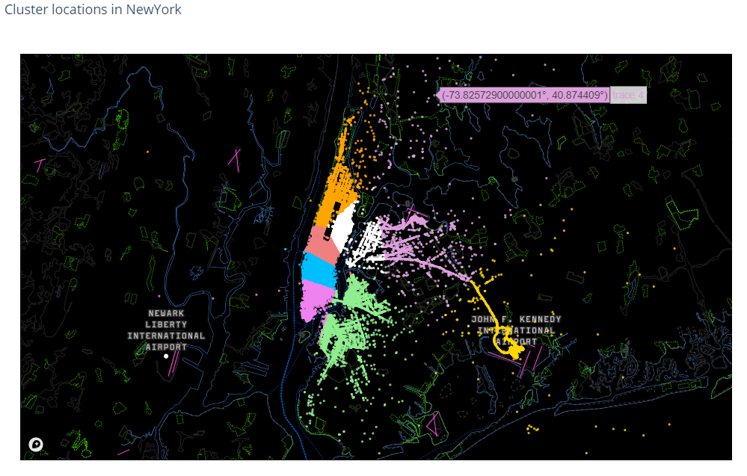
Open questions
maximize your earnings with 10 taxis
Strategies to be used:
Ensure own taxis do not compete with each other for rides. Deploy taxis in different clusters of the city based on demand
Friday, Saturday & Sunday afternoon till midnight are the durations for which the taxi demand is maximum. Ensure availability of taxi during this period by having enough number of drivers to work in shifts and also having the taxis serviced in advance and ready for this period
Instruct taxi drivers to focus on the routes with the highest earnings per hour (or earnings per mile)

Slide 19
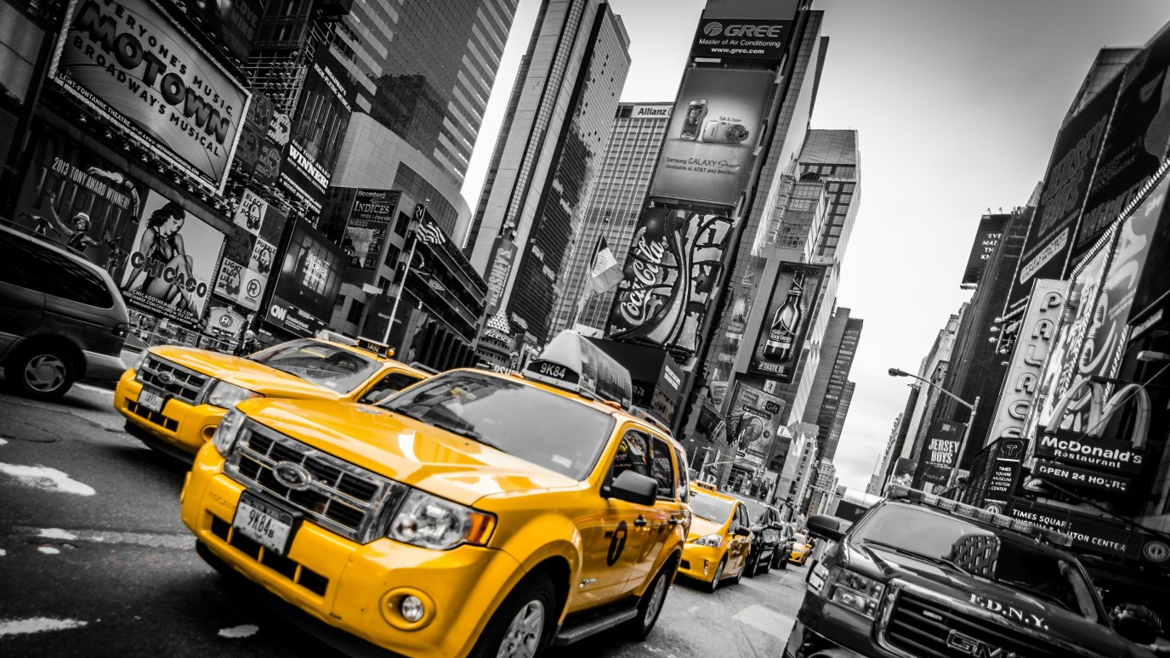
Thank you

